Slide 1
Circularly Singly Linked List
Karthikeyan S
Faculty/VIT University
Amaravati
Karthik

Slide 2
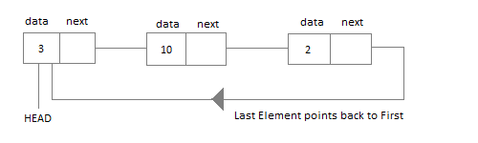
Circular Linked List
Circular Linked List is little more complicated linked data structure. In the circular linked list we can insert elements anywhere in the list whereas in the array we cannot insert element anywhere in the list because it is in the contiguous memory. In the circular linked list the previous element stores the address of the next element and the last element stores the address of the starting element. The elements points to each other in a circular way which forms a circular chain. The circular linked list has a dynamic size which means the memory can be allocated when it is required.

Slide 3

Why Circular? In a singly linked list, for accessing any node of linked list, we start traversing from the first node. If we are at any node in the middle of the list, then it is not possible to access nodes that precede the given node. This problem can be solved by slightly altering the structure of singly linked list. In a singly linked list, next part (pointer to next node) is NULL, if we utilize this link to point to the first node then we can reach preceding nodes. Refer this for more advantages of circular linked lists.
The structure thus formed is circular singly linked list look like this:

Slide 4
Why have we taken a pointer that points to the last node instead of first node ?
For insertion of node in the beginning we need traverse the whole list. Also, for insertion and the end, the whole list has to be traversed. If instead of start pointer we take a pointer to the last node then in both the cases there won’t be any need to traverse the whole list. So insertion in the begging or at the end takes constant time irrespective of the length of the list.

Slide 5
Insertion
A node can be added in three ways:
Insertion in an empty list
Insertion at the beginning of the list
Insertion at the end of the list
Insertion in between the nodes

Slide 6
Application of Circular Linked List
The real life application where the circular linked list is used is our Personal Computers, where multiple applications are running. All the running applications are kept in a circular linked list and the OS gives a fixed time slot to all for running. The Operating System keeps on iterating over the linked list until all the applications are completed.
Another example can be Multiplayer games. All the Players are kept in a Circular Linked List and the pointer keeps on moving forward as a player's chance ends.
Circular Linked List can also be used to create Circular Queue. In a Queue we have to keep two pointers, FRONT and REAR in memory all the time, where as in Circular Linked List, only one pointer is required.

Slide 7
Implementing Circular Linked List
Implementing a circular linked list is very easy and almost similar to linear linked list implementation, with the only difference being that, in circular linked list the last Node will have it's next point to the Head of the List. In Linear linked list the last Node simply holds NULL in it's next pointer.

Slide 8

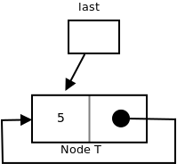
Insertion in an empty List
Initially when the list is empty, last pointer will be NULL.
After inserting a node T,

Slide 9
After insertion, T is the last node so pointer last points to node T. And Node T is first and last node, so T is pointing to itself.
Function to insert node in an empty List,
struct Node *addToEmpty(struct Node *last, int data)
{
// This function is only for empty list
if (last != NULL)
return last;
// Creating a node dynamically.
struct Node *last =
(struct Node*)malloc(sizeof(struct Node));
// Assigning the data.
last -> data = data;
// Note : list was empty. We link single node
// to itself.
last -> next = last;
return last;
}

Slide 10
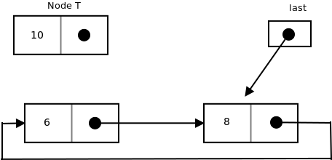
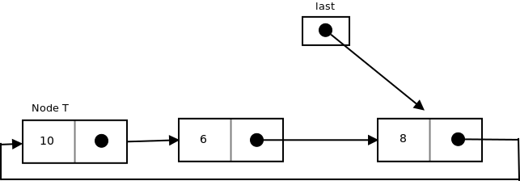
Insertion at the beginning of the list
To Insert a node at the beginning of the list, follow these step:
1. Create a node, say T.
2. Make T -> next = last -> next.
3. last -> next = T.
Before insertion,
After insertion,

Slide 11
Function to insert node in the beginning of the List,
struct Node *addBegin(struct Node *last, int data)
{
if (last == NULL)
return addToEmpty(last, data);
// Creating a node dynamically.
struct Node *temp
= (struct Node *)malloc(sizeof(struct Node));
// Assigning the data.
temp -> data = data;
// Adjusting the links.
temp -> next = last -> next;
last -> next = temp;
return last;
}

Slide 12
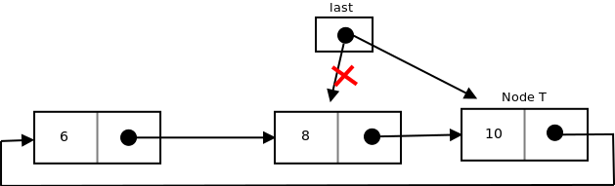
Insertion at the end of the list
To Insert a node at the end of the list, follow these step:
1. Create a node, say T.
2. Make T -> next = last -> next;
3. last -> next = T.
4. last = T.
After insertion,

Slide 13
Function to insert node in the end of the List,
struct Node *addEnd(struct Node *last, int data) { if (last == NULL) return addToEmpty(last, data); // Creating a node dynamically. struct Node *temp = (struct Node *)malloc(sizeof(struct Node)); // Assigning the data. temp -> data = data; // Adjusting the links. temp -> next = last -> next; last -> next = temp; last = temp; return last; }

Slide 14
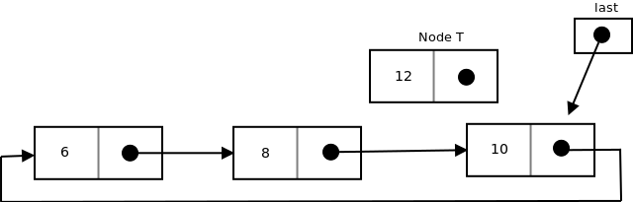
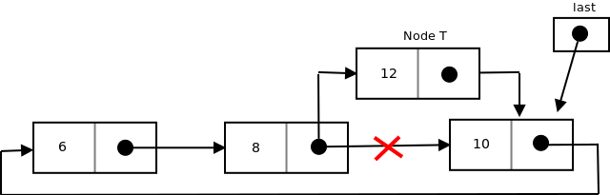
Insertion in between the nodes
To Insert a node at the end of the list, follow these step:
1. Create a node, say T.
2. Search the node after which T need to be insert, say that node be P.
3. Make T -> next = P -> next;
4. P -> next = T.
Suppose 12 need to be insert after node having value 10,
After searching and insertion,

Slide 15
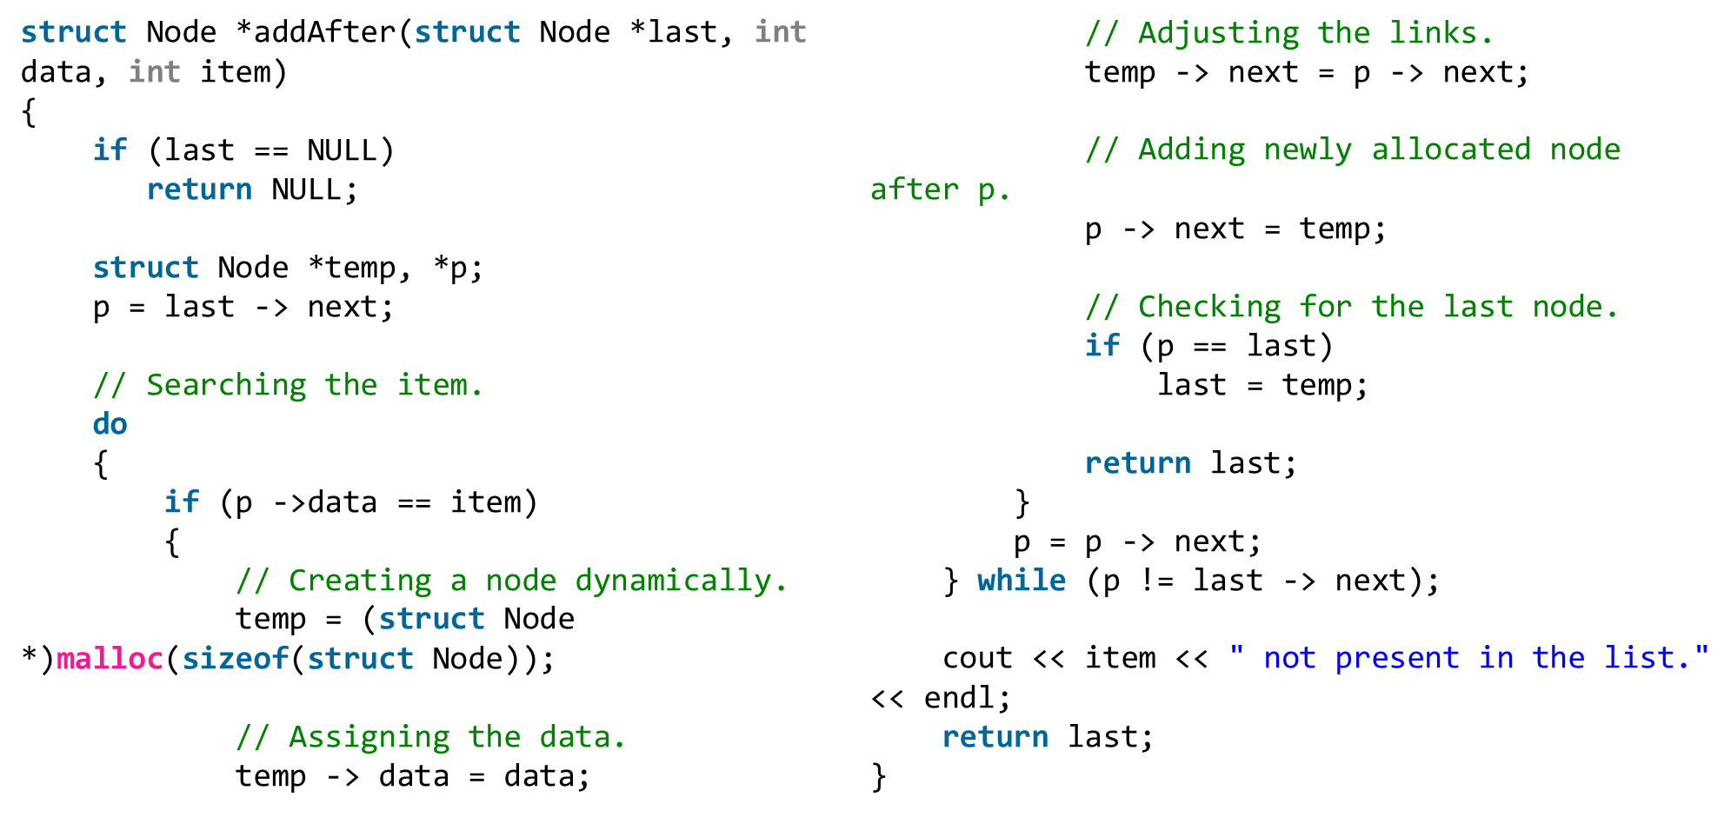
Function to insert node in the end of the List,

Slide 16


